Slide 1

Time Management & Productivity
"Time and tide doesn’t wait for anyone"
Presented by Ali Danish

Slide 2

What and Why It Matters
What It Is
Why It Matters
Time Management: The art of planning and
consciously allocating your time to specific
activities.
Achieve better grades and higher quality work.
Reduce stress and free up personal time.
Productivity: Achieving valuable results and
output from the time you invest.
Enhance career prospects and opportunities.
The core idea is simple: effective time management creates a solid foundation for consistent productivity.

Slide 3
Key Concepts Defined
Time Management
Productivity
More than just scheduling, it's about prioritizing and protecting your valuable time slots from interruptions.
It's a measure of output quality and the value generated per unit of time invested. It's not just about doing more, but doing better.
Efficiency vs. Effectiveness
Prioritization
Are you doing things right (efficiency), or are you doing the right things (effectiveness)? Both are crucial for true productivity.
Deciding what truly deserves your focused attention and best effort. The most productive work combines both urgent and important tasks.

Slide 4




IMPACT
Transforming Your Life & Career
Academic & Work Excellence
Reduced Stress & Procrastination
Improved performance leads to better grades and higher quality output in all your endeavors.
Proactive planning minimizes last-minute rushes and the anxiety that comes with them.
More Time for Growth
Enhanced Reputation
Creates valuable space for continuous learning, nurturing relationships, and essential rest.
Being reliable and efficient builds trust, opening doors to better opportunities and responsibilities.

Slide 5
Practical Strategies for Success
1
Time-Blocking
Allocate specific blocks in your calendar for dedicated tasks. Treat these blocks like appointments you cannot miss.
2
Pomodoro Technique
Work in short, focused 25-minute sprints, followed by 5-minute breaks. This method boosts concentration.
3
Eisenhower Matrix
Categorize tasks by "urgent vs. important" to prioritize effectively. Focus on tasks that are important but not yet urgent.
4
Batching & Single-Tasking
Group similar tasks together (e.g., all emails). Avoid multitasking to improve focus and quality of work.
5
Getting Things Done (GTD)
A comprehensive system: capture all tasks, clarify what they mean, organize them, review regularly, and then "do" them.

Slide 6

REAL-LIFE
Impact in Action: Case Studies
Student Success
A student uses weekly study blocks and the Pomodoro Technique. The result: less cramming, better retention of material, and a significantly calmer exam week experience.
Team Productivity
A team implements a shared calendar and a Kanban task board. This leads to fewer unproductive meetings, clearer ownership of tasks, and faster project delivery.
Personal Efficiency
Tracking work hours for a week reveals several hours daily spent on low-value activities. Identifying these "time leaks" allows for strategic reclamation of time.

Slide 7




Overcoming Common Challenges
Procrastination
Distractions
Solution: Take a start and take a tiny 5-10 minute sprint on a task. Often this helps you build momentum on the thing you want to do
Solution: Turn off notifications, use focus modes on devices, and establish a dedicated, clutter-free workspace.
Overcommitment
Poor Time Estimates
Solution: Do not overcommit on the tasks you cannot do take one step at a time.
Solution: Track your time for a week. Regularly review how long tasks actually take to improve future planning accuracy.

Slide 8
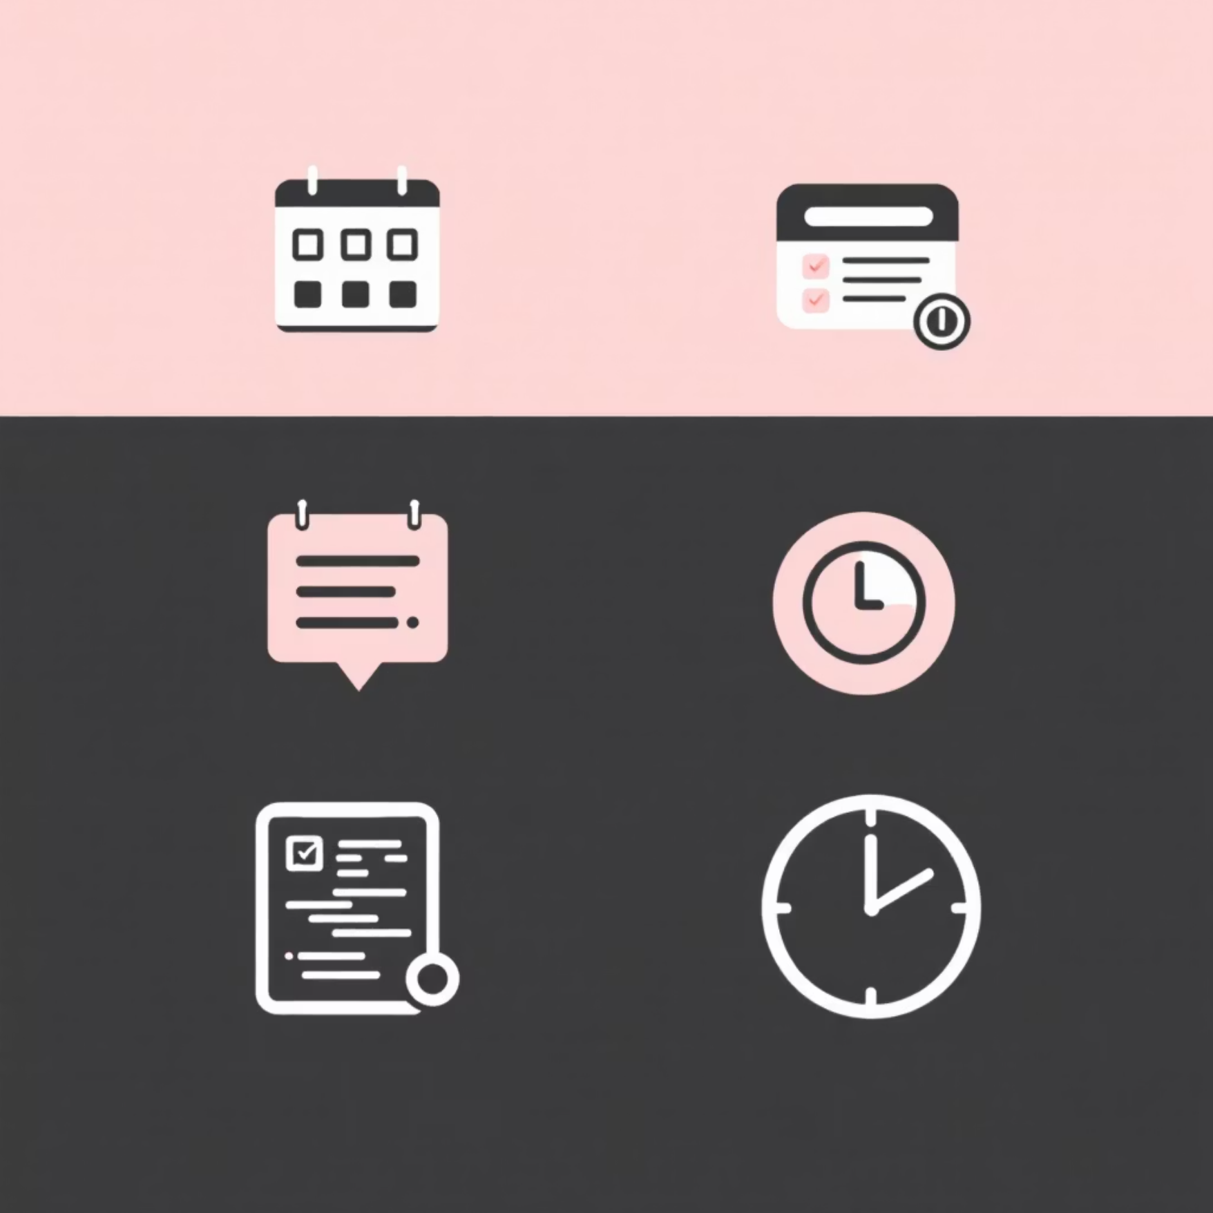

Essential Tools & Resources
Digital Tools
Analog & Learning
Calendars: Google Calendar, Outlook (for time-blocking).
Task Managers: Todoist, Microsoft To Do, Things, Asana (for lists & priorities).
Analog: Daily planners, bullet journals (for tactile clarity).
Project Boards: Trello, Notion, Jira (for visual workflow).
Books: "Getting Things Done" (David Allen),
"Deep Work" (Cal Newport), "Atomic Habits" (James Clear).
Timers & Tracking: Pomofocus, Toggl, RescueTime
(for focused sprints and data).

Slide 9





Summary: Your Path to Productivity
Interconnected Concepts
Time management isn't just about managing hours, it's the enabler of true productivity.
Prioritize & Protect
Focus on important tasks, schedule them deliberately, and guard your focused work time fiercely.
Simple, Consistent Systems
Adopt a core system: time-blocking + Pomodoro + a weekly review to stay on track.
Identify Time Leaks
Track your time for just one week to uncover hidden distractions and reclaim lost hours.
Start Small, Grow Big
Implement one small change for seven days. Observe the feedback and let habits compound into major results.

Slide 10

The Journey Begins
Consistency beats intensity — small, deliberate habits compound into major, lasting results. Start today.

